Slide 3


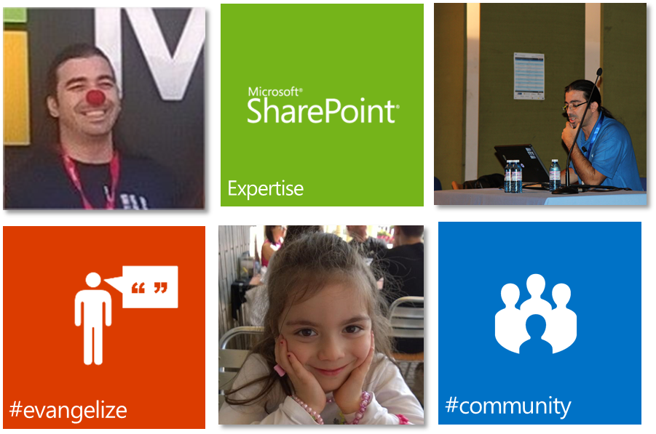


Rodrigo Pinto
everis
SharePoint Solution Architect
SharePoint Server MVP
http://www.rodrigopinto.eu
http://www.sharepointpt.org
@scoutmanpt

Slide 4

Set up an SharePoint On-Premises environment for developing Provider-Hosted Apps

Slide 5
Agenda
the need
start
understand
setup
tips
&tricks
don'ts

Slide 6

Why are we still developing on premises

Slide 7
Provider-Hosted Apps

Slide 8
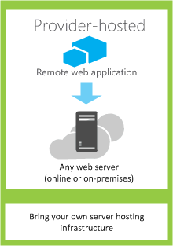
Provider-Hosted Apps
Where the app components are hosted
Any web server or hosting service
How the app gets authorized
OAuth or the JavaScript cross-domain library
What language the app can use
Any language supported by a web server or
hosting service

Slide 9

Where to get started?

Slide 10
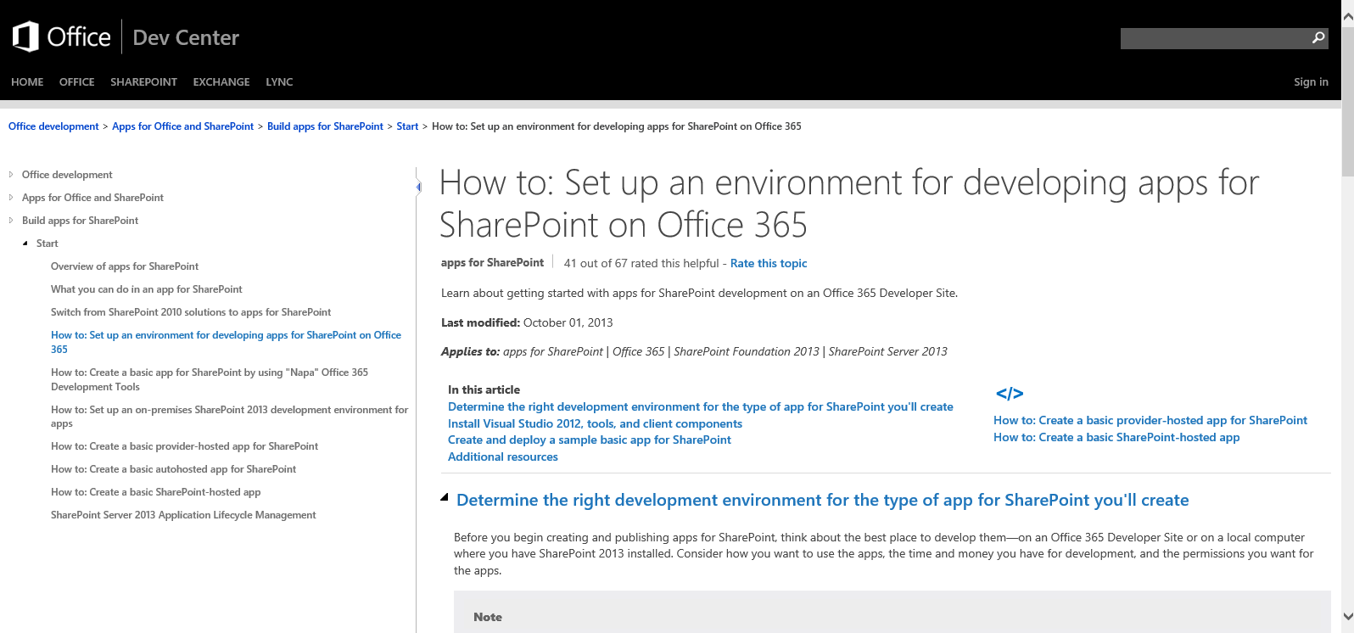
http://aka.ms/SPOLocalDevSetup

Slide 11

Enviroment

Slide 12
Environment
x64-capable CPU
at least 16 GB of RAM (24 GB of RAM ideal setup)
Windows Server 2008 R2 Service Pack 1 x64 or Windows Server 2012
SQL SERVER 2008 R2 SP1/2012/2014 (SharePoint SP1)

Slide 13
Environment
Virtualize!
HyperV, Vmware, Vbox
Use Azure VMs
Use an All-IN VM
Active Directory / DNS
SQL Server
(2008 R2 SP1/2012/2014*)
SharePoint
TIP!
Use AutoSPInstaller, and AutoSPSourceBuilder
http://AutoSPInstaller.codeplex.com; http://AutoSPSourceBuilder.codeplex.com
* with SharePoint SP1

Slide 14
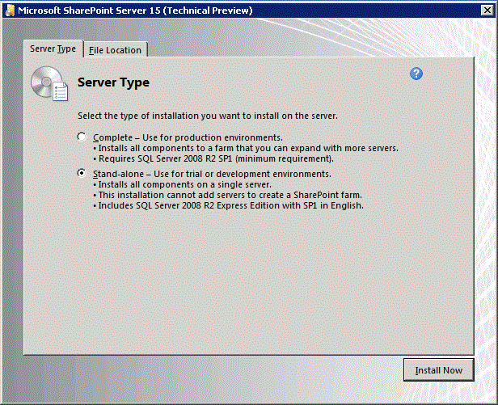
Environment
Pre-Requisites
Warning!
Always consider complete Installation
if you are doing FTC & App Dev Model
Limit Storage: SQL Server 2008 R2 SP 1 Express version storage limit to 10 GB per DB
No Domain Service or domain accounts
Run under local accounts ( like Network Service account)
Can not create User Profile Service

Slide 15
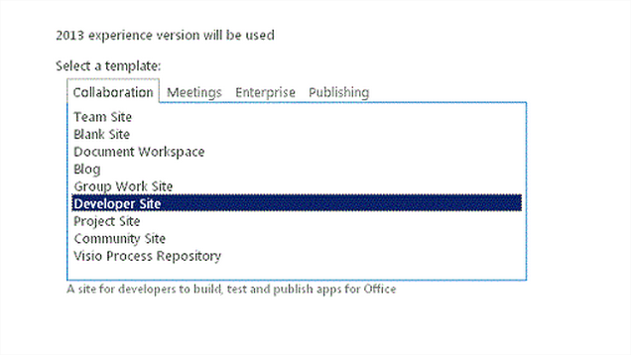
Environment

Slide 16
Environment
Minimum Services Running
User Profile Service Application
(at least one account* crawled with email)
App Management Service
Subscription settings Service
*account must have email configured

Slide 17

Setup

Slide 18

SETUP
Pre-Requisites
Steps to be taken
Set Forward Lookup Zone
Create App Domain
Create a Certificate
Configure SharePoint 2013 to use certificates
Create a new Developer Site

Slide 19

Tips

Slide 20

Tips
Developer user cant be farm admin
Make sure all SP Services are running
Check the loopback check
Add the IP of the server to the host file.

Slide 21
Rodrigo Pinto
everis
SharePoint Solution Architect
SharePoint Server MVP
http://www.rodrigopinto.eu
http://www.sharepointpt.org
@scoutmanpt

